Slide 1
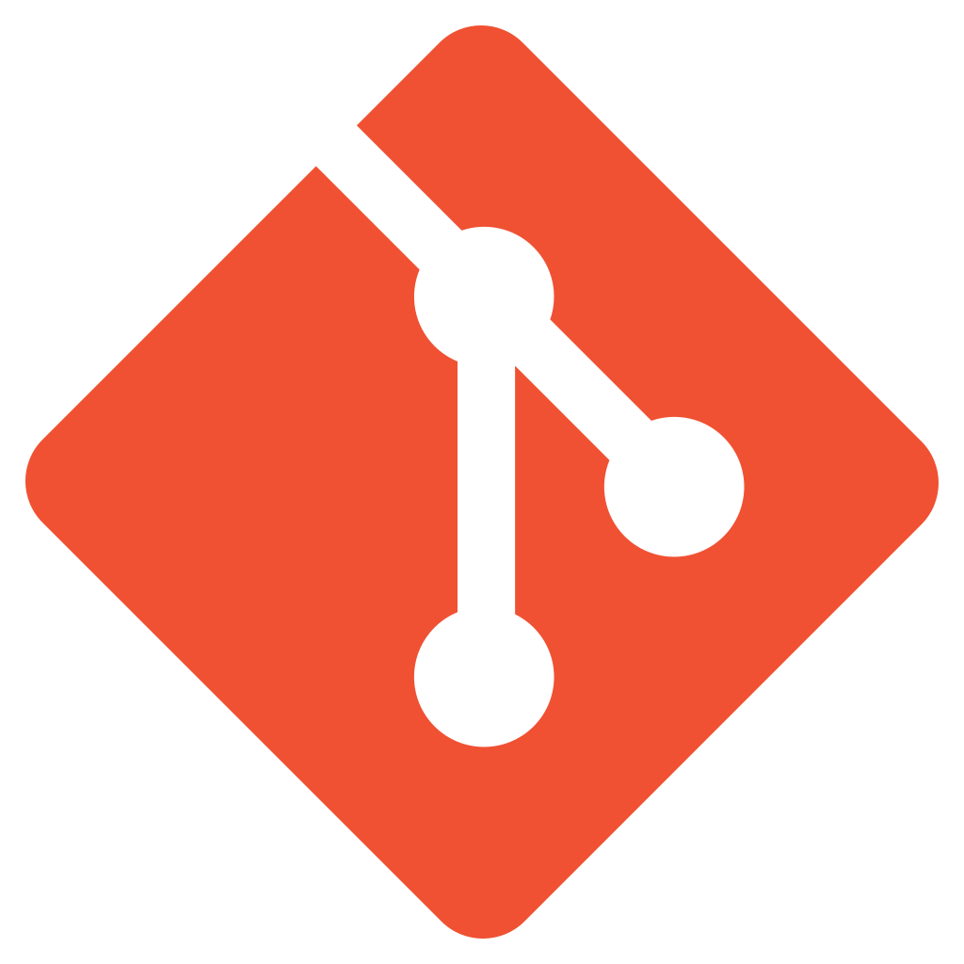
GDB and Git
Michael Baccia

Slide 2
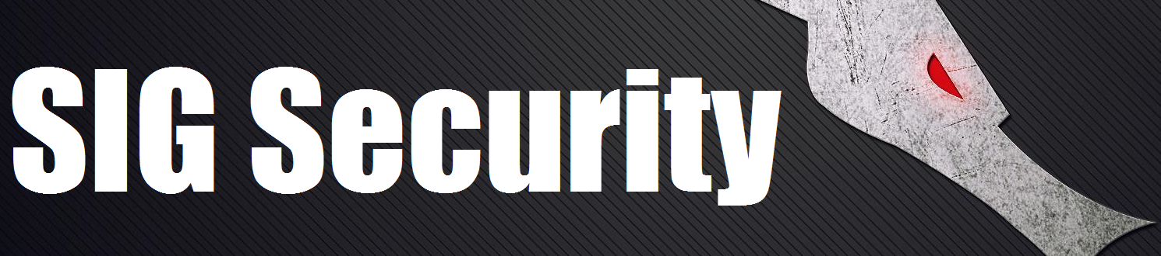
Who am I?
Vice President of LUG
Final year at UIC! ;(
Interest in Security
Shameless plug for my SIG

Slide 3
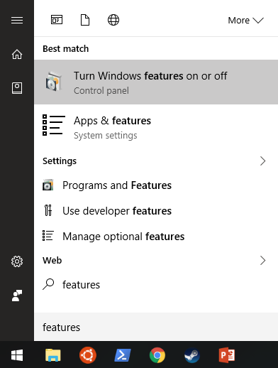
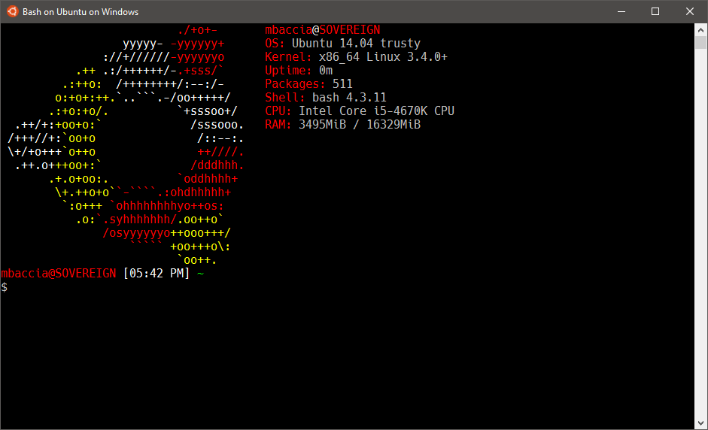
No Linux? No problem!
Windows 10 recently added Bash for Windows with the Anniversary update!
Enable in control panel under Programs and Features -> Turn features on or off:

Slide 4
What is GDB?
GNU Project DeBugger
Multi-Platform debugger for C, C++, Objective-C and others.
Command-line interface
Many debugger act as a graphical interface to GDB, while others can interface with it!
Xcode debugger (front-end)
Eclipse, Netbeans, Qt Creator, Visual Studio (interface)

Slide 5
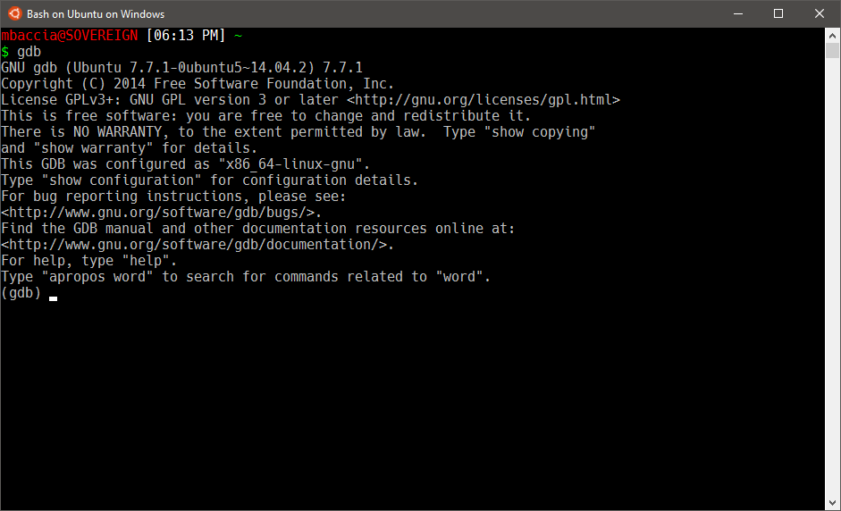
Interface

